Slide 1
Flood Prediction Using Various Machine Learning Model
Name: Jayed Bin Harez
ID:1912085642
Course:CSE-498r
Faculty Initial: MEZ

Slide 2
Background & Motivation
Background
Motivation
Advancements in Machine Learning Technology
Impact on Agriculture and Economy
Geographical Vulnerability
Reduce Economic Losses
Improve Disaster Preparedness
Save Lives:
Advance Scientific Research

Slide 3
Literature Survey
01
02
Noushin and her crew [1] predicted flood using machine learning algorithms. They chose theweather data of Bangladesh for 65 years taken from Kaggle dataset. In their dataset the total number of instances was 20543. They used the k-Nearest Neighbors Algorithm and gave them a maximum accuracy of 94.91.
Rajab and her groupmate [2] predicted Flood Forecasting using machine learning algorithms. They had chosen data from 1948 to 2013, the dataset includes comprehensive monthly averages for Bangladesh that are area-specific for maximum temperature, minimum temperature, rainfall, relative humidity, wind speed, cloud cover, and brilliant sunshine dataset. In their dataset that can be found in which consists of 21,120 records. They used k-Nearest Neighbors Algorithm, and gave them a maximum accuracy of 89.2.
03
Anil and his crew predicted flood using machine learning models. They have used xgboost , Logistic Regression(LR), Decision Tree(DT), and KNN algorithms.By training the model they got accracy of xgboost(.993) , Logistic Regression(.987), Decision Tree(.993), and KNN algorithms(.987).They got height accuracy by using xgboost which is 99.3%.
04
Kruti and her team[4] developed a flood prediction system which used various machine learning algorithms.They collected the dataset from f Bihar and Orissa from 1992-2002.They have used Decision Tree Algorithm, Gradient Boost Algorithm, Random Forest Algorithm.Among this model they got height accuracy form Decision Tree Algorithm which was 94.4%.

Slide 4
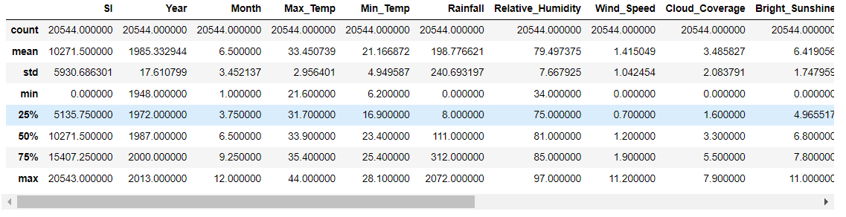
Methodology
Comprehensive Data Source
Rich Feature Set
Reliable Data Repository
Figure 01. A concise summary of the dataset of the Flood Prediction Using Various ML model

Slide 5
Techniques used for Hyperparameter Tuning
Feature Scaling
Hold-Out Validate
Replace null values with mean
Using label encoder
Min max scaler
Training & Testing dataset split
GridSearch CV
Randomized Search CV
Used to fine tune the Hyperparameters
Used to fine tune the Hyperparameters

Slide 6
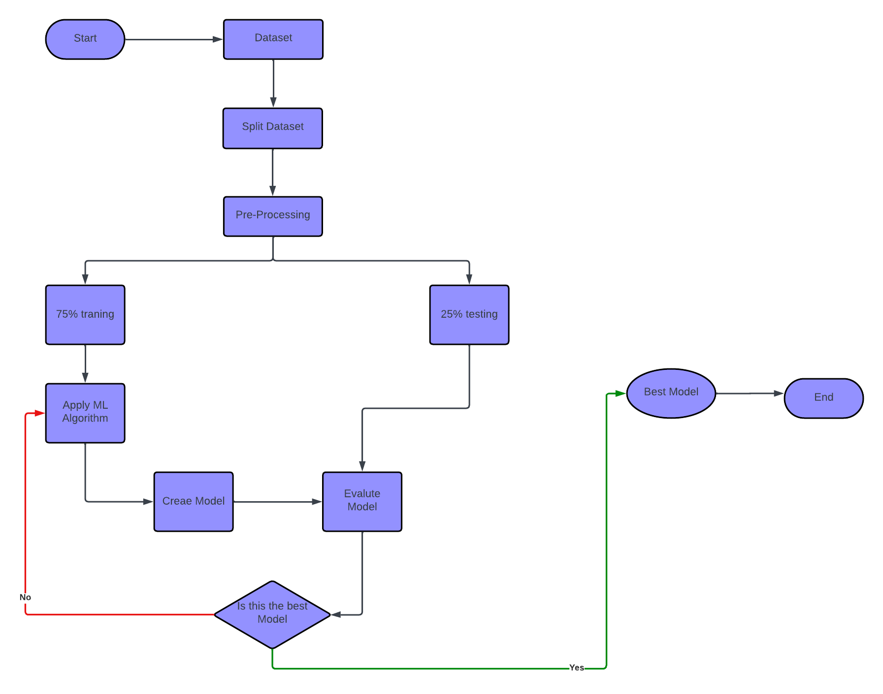
Flow Chart Diagram | Projected Plan
Figure 02: Flow chart of Flood Prediction Using Various ML model

Slide 7
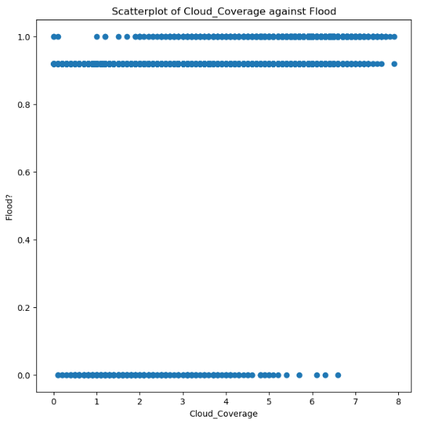
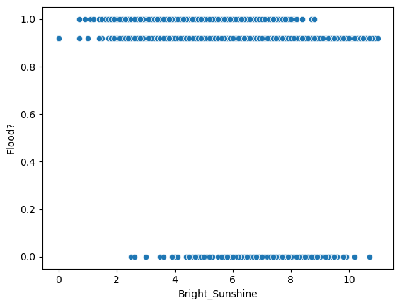
Result & Discussion
Figure 03. Scatterplot of Cloud_Coverage against Flood using Seaborn
Figure 04. Scatterplot of Bright_Sunshine against Flood using Seaborn

Slide 8
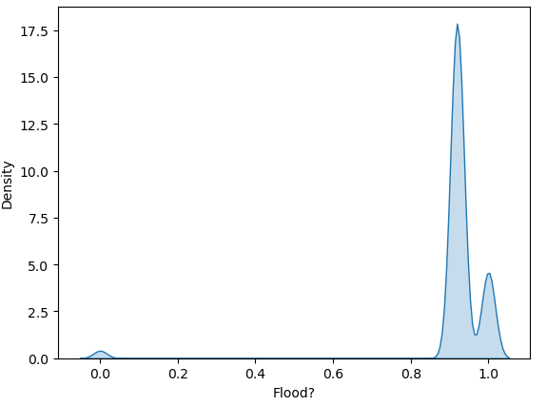
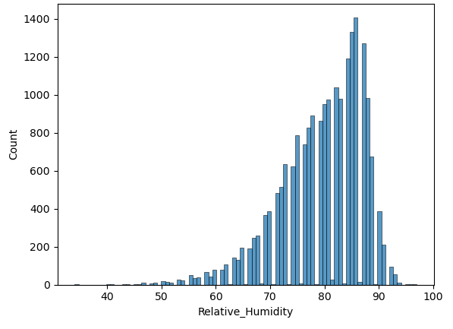
Figure 04. KDE plot density for Flood
Figure 06. Hisplot for the Relative_Humidity

Slide 9
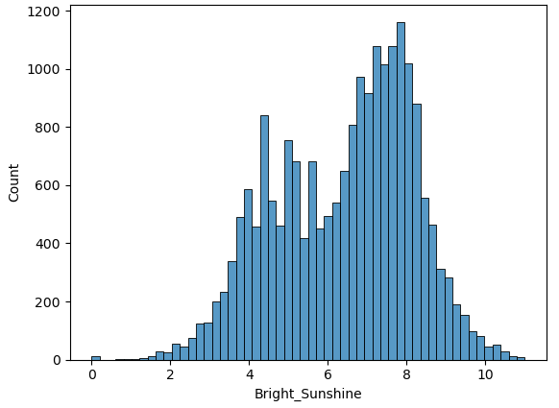
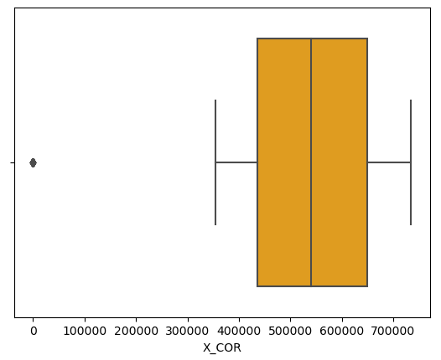
Figure 07. Hisplot for the Bright_Sunshine
Figure 08. Boxplot for X_COR

Slide 10
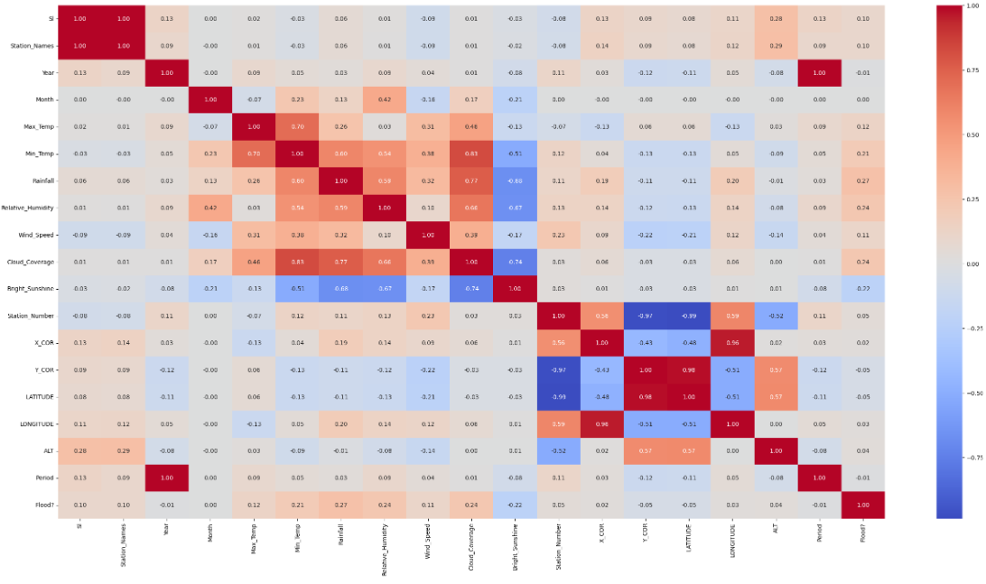
Figure 07. Correlation matrix for the project

Slide 11
Without Hyperparameter
Model | Accuracy Score | Recall Score | ROC score
KNN | 94.139408 | 84.549763 | 90.584119
Logistic Regression | 94.450935 | 84.644550 | 90.815291
SVC | 94.373053 | 83.507109 | 90.344586
Random Forest | 95.035047 | 84.644550 | 91.182848
Decision Tree | 92.289720 | 82.085308 | 88.506511
Table 1: Accuracy, ROC, Recall of the models without hyperparameter

Slide 12
With Hyperparameter
Model | Accuracy Score | Recall Score | ROC score
KNN | 94.470405 | 83.412322 | 90.37070
Logistic Regression | 94.489875 | 84.549763 | 90.804654
SVC | 94.548287 | 82.748815 | 90.173721
Random Forest | 95.229751 | 95.229751 | 91.65678
Decision Tree | 94.217290 | 83.127962 | 90.106005
Table 2: Accuracy, ROC, Recall of the models without hyperparameter

Slide 13
Future Improvement
Integration of Remote Sensing Data
Utilization of Advanced Modeling Techniques
Real-time Data Acquisition and Processing
Continuous Monitoring and Model Updating

Slide 14
References
[1] N. Gauhar, S. Das, and K. S. Moury, “Prediction of flood in Bangladesh using K-nearest neighbors algorithm,” 2021 2nd International Conference on Robotics, Electrical and Signal Processing Techniques (ICREST), Jan. 2021. doi:10.1109/icrest51555.2021.9331199
[2] A. Rajab et al., “Flood forecasting by using Machine Learning: A Study Leveraging Historic Climatic Records of Bangladesh,” Water, vol. 15, no. 22, p. 3970, Nov. 2023. doi:10.3390/w15223970
[3] A. K. Ambore, T. S. Charan, U. R. Reddy, T. S. Reddy, and Tarun. G, “Flood prediction using machine learning,” International Journal for Research in Applied Science and Engineering Technology, vol. 11, no. 5, pp. 363–367, May 2023. doi:10.22214/ijraset.2023.51528
[4] K. Kunverji, K. Shah, and N. Shah, “A flood prediction system developed using various machine learning algorithms,” SSRN Electronic Journal, 2021. doi:10.2139/ssrn.3866524

Slide 15
Thank You

